Slide 1
2018 EDG Summer Intern Final Presentation
August 21, 2018

Slide 2
Agenda
Introduction
Individual Contribution: Henry Huynh
Project Overview: EDG Ticketing System Data Mining Project
Ticketing Analytics Dashboard (TAD) Project
Business Use Case
Solution Diagram
QA Results
Root Cause Analysis (RCA)
Individual Contribution:
Romeo Scagliarini
Carlos Amezquita
Shawn Le
Eric Vela
Q&A

Slide 3
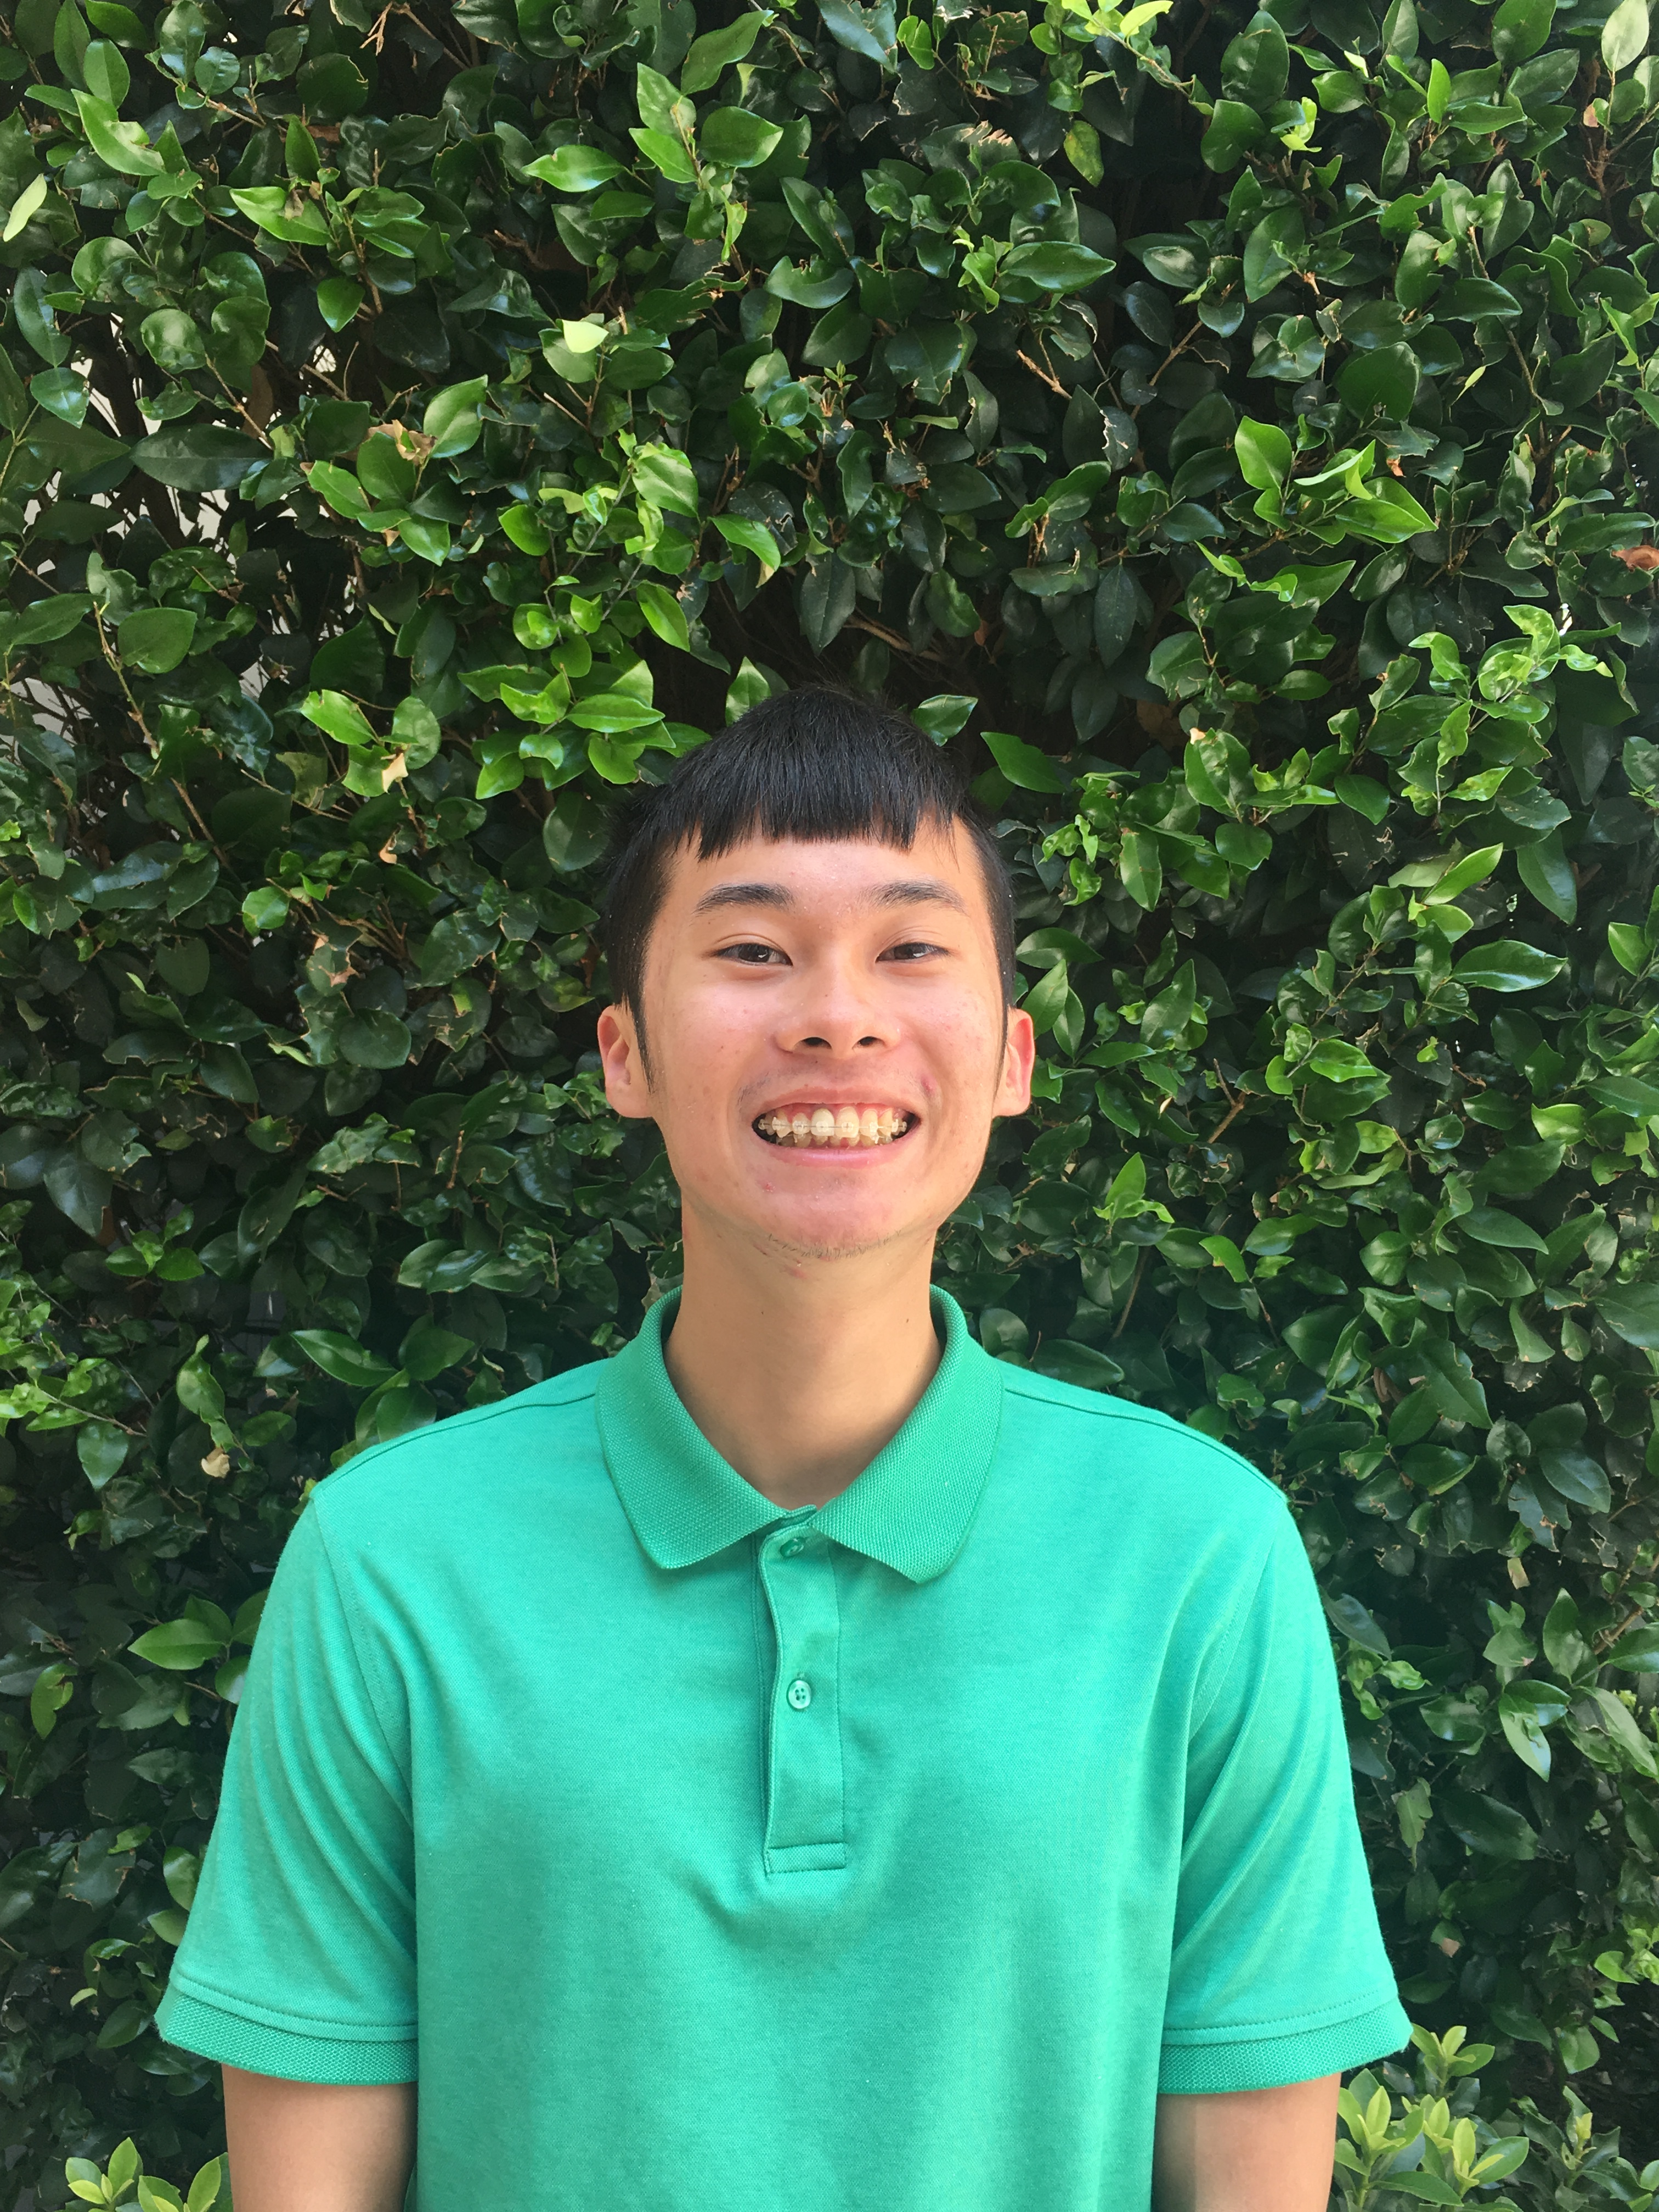

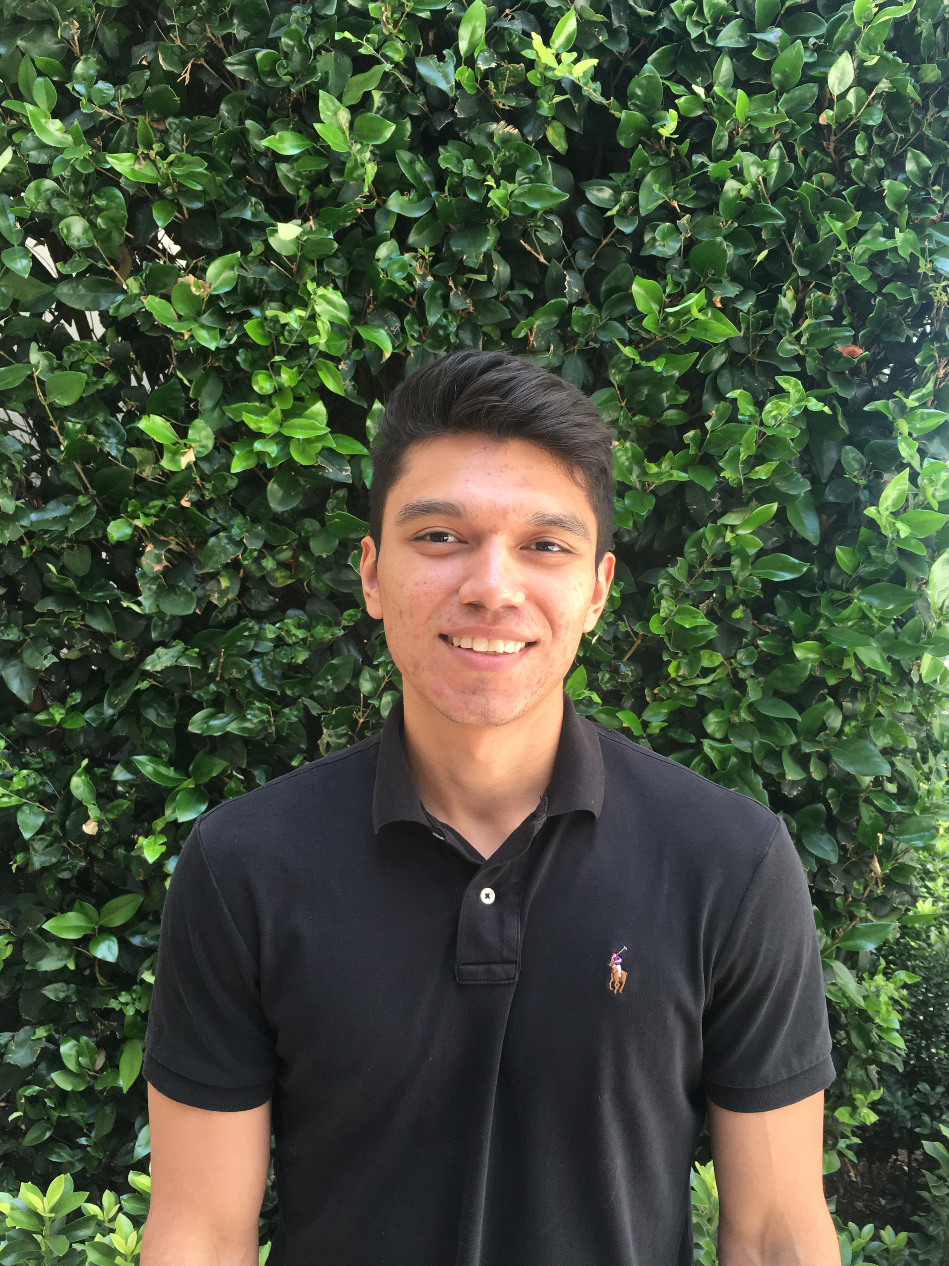

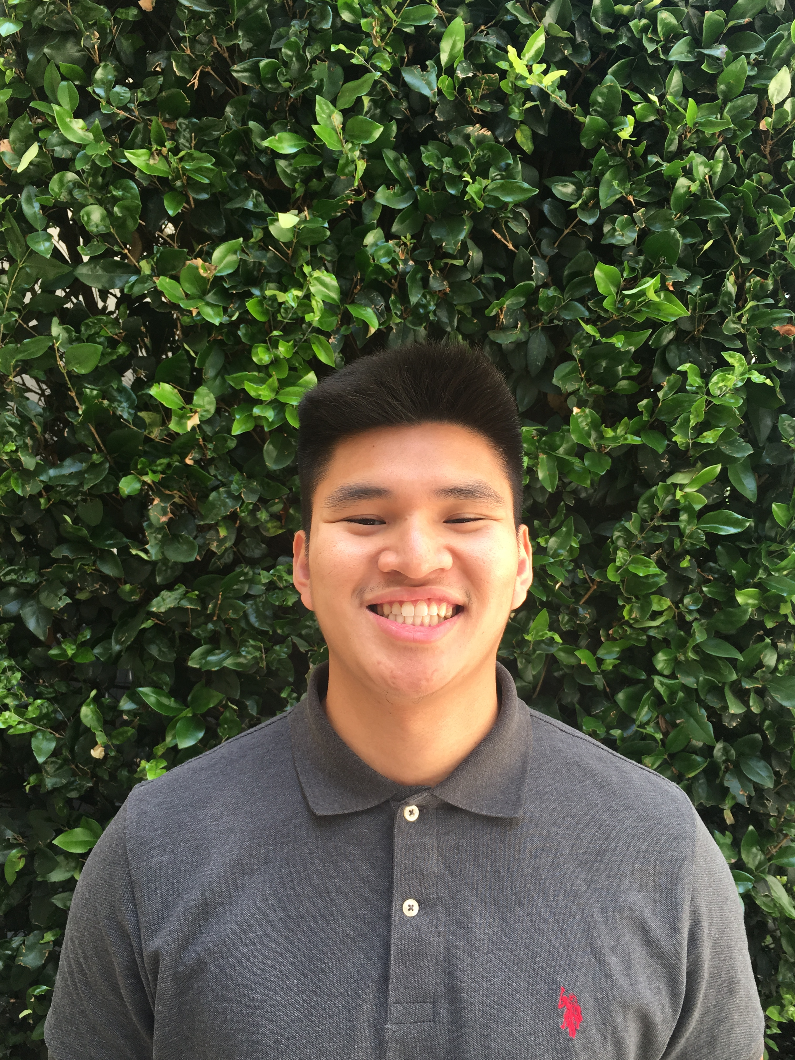
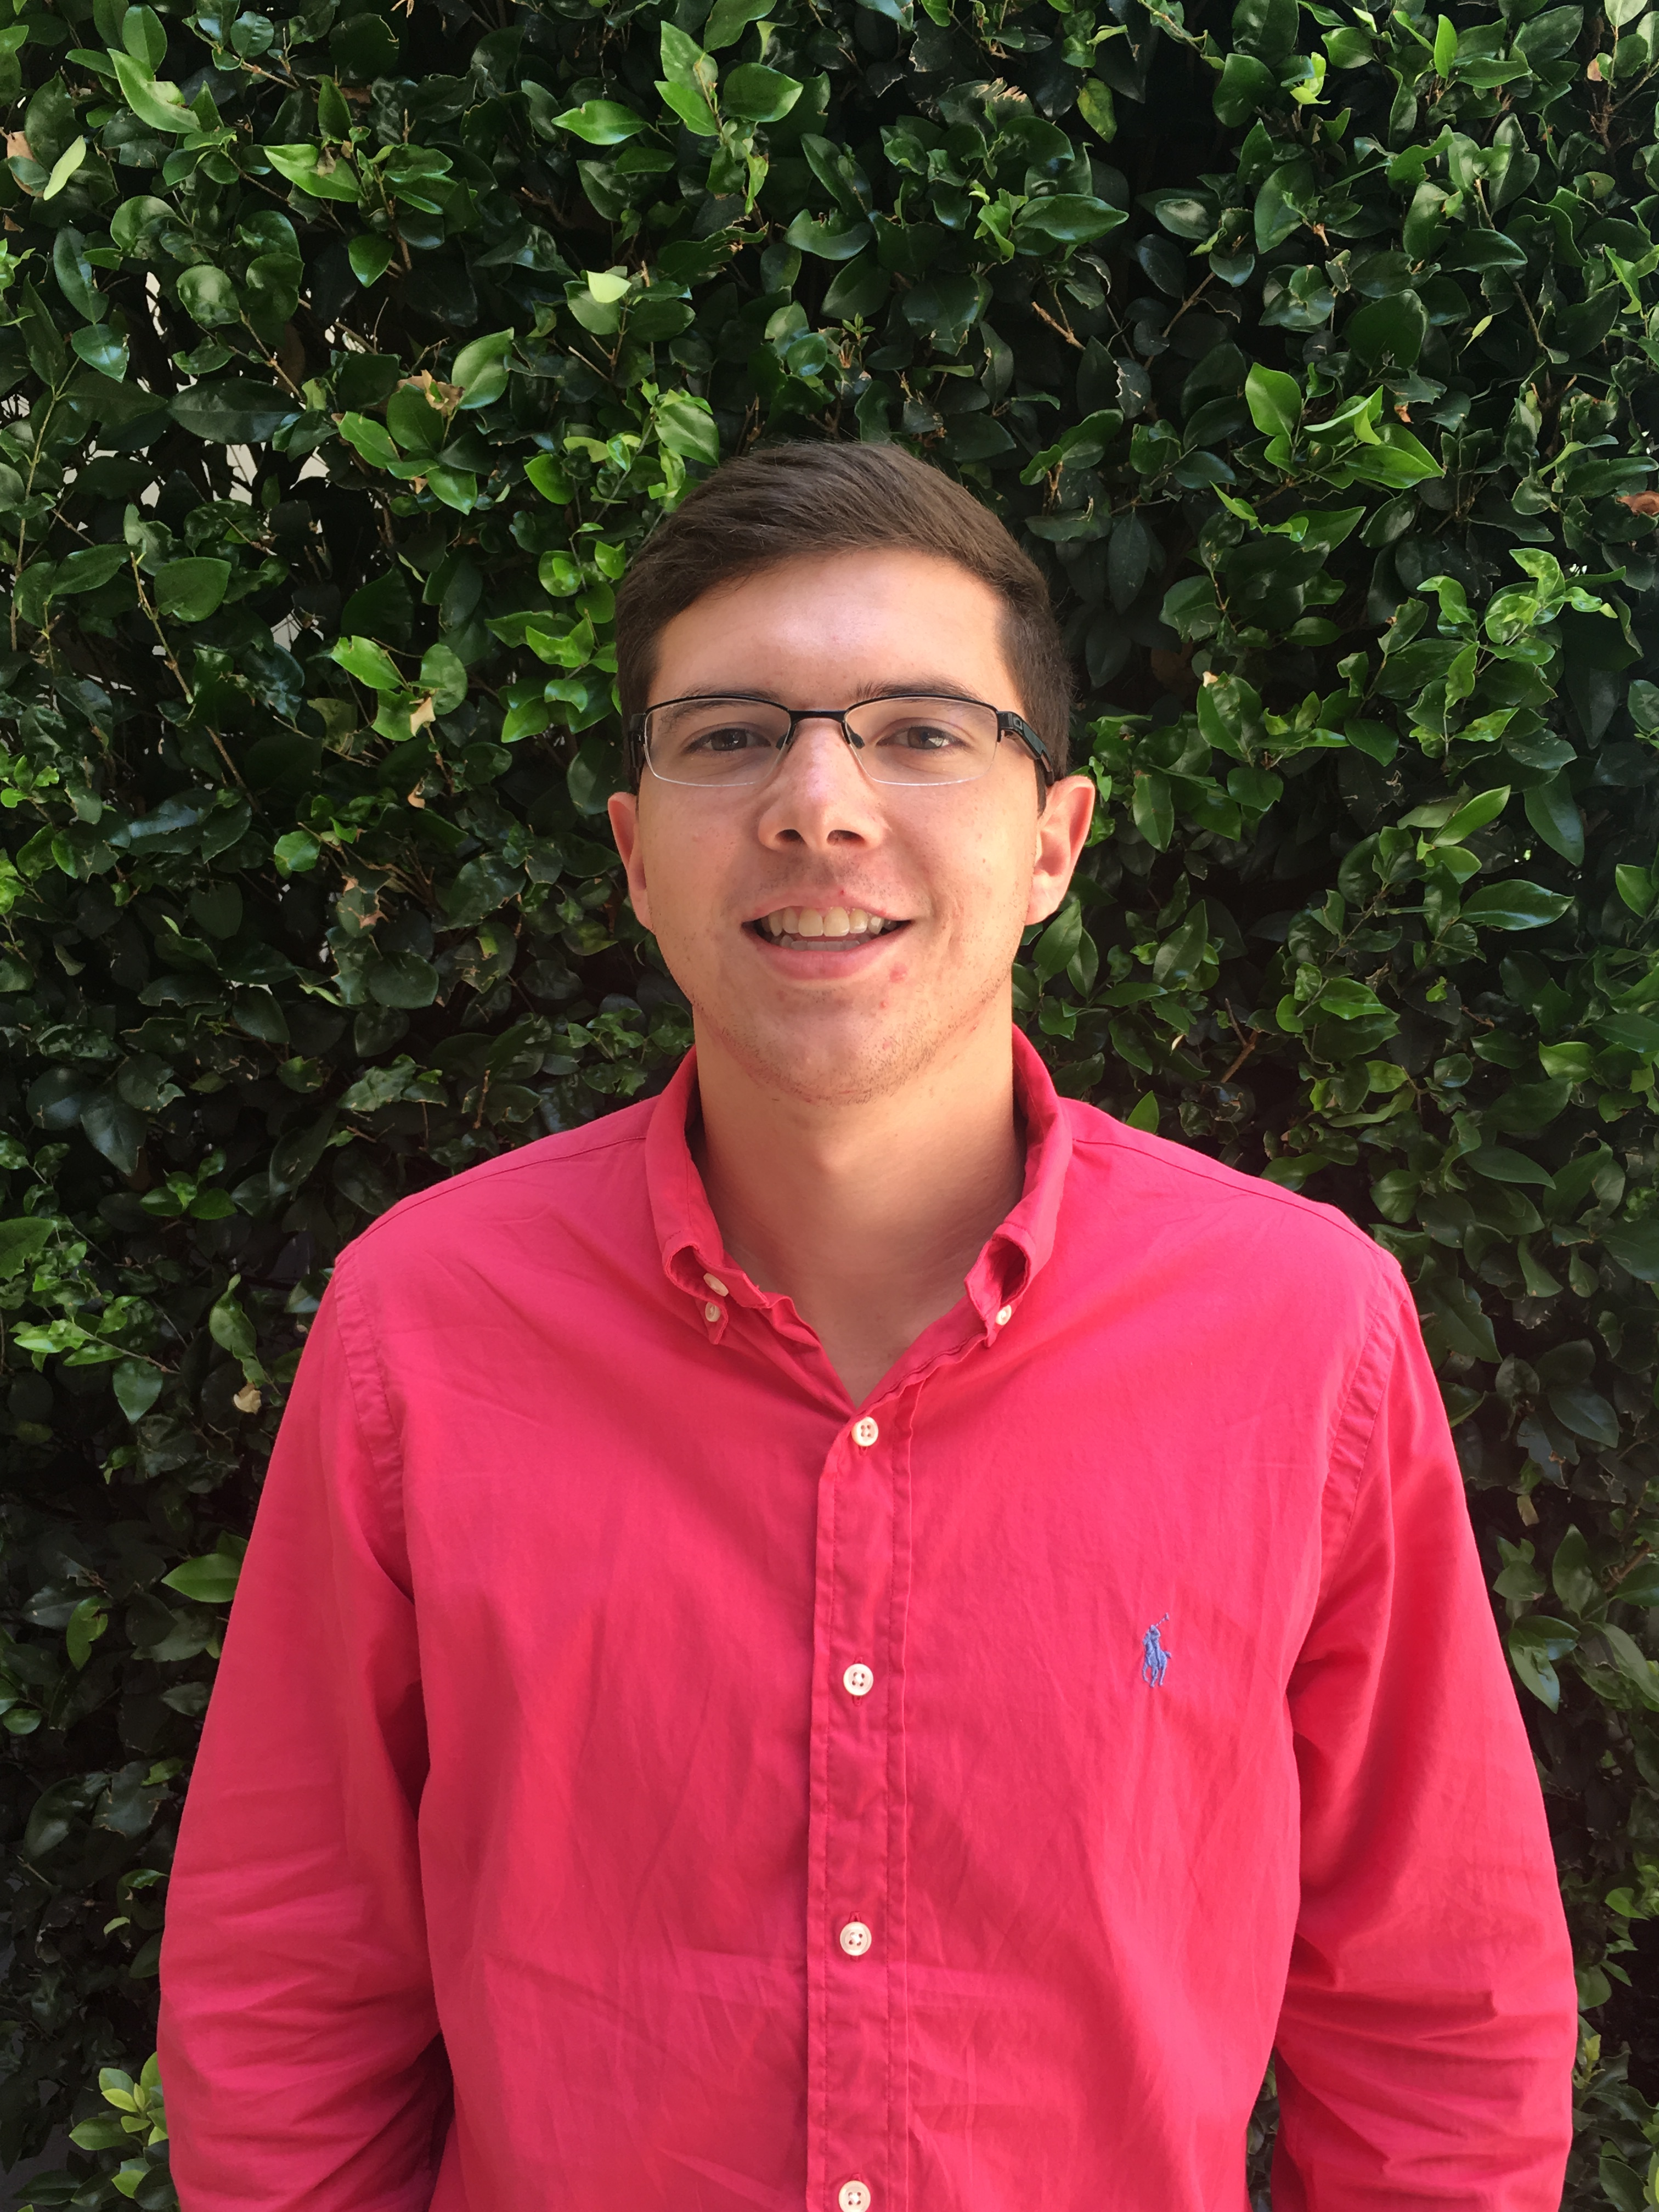
EDG Summer Interns
Shawn Le
Intern, Data Science
Eric Vela
Intern, Data Analyst
Carlos Amezquita
Intern, Project Mgmt.
Henry Huynh
Intern, QA
Romeo Scagliarini
Intern, QA

Slide 4
Individual Contribution
Henry Huynh

Slide 5
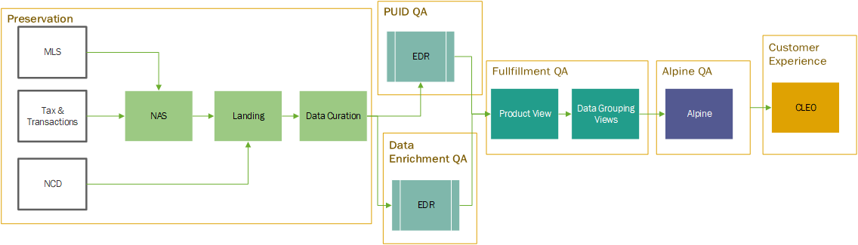
What is IDAP?
A Smart Data Platform
Goals
Property Unique Identifier (PUID)
Data Enrichment
Fast Delivery

Slide 6
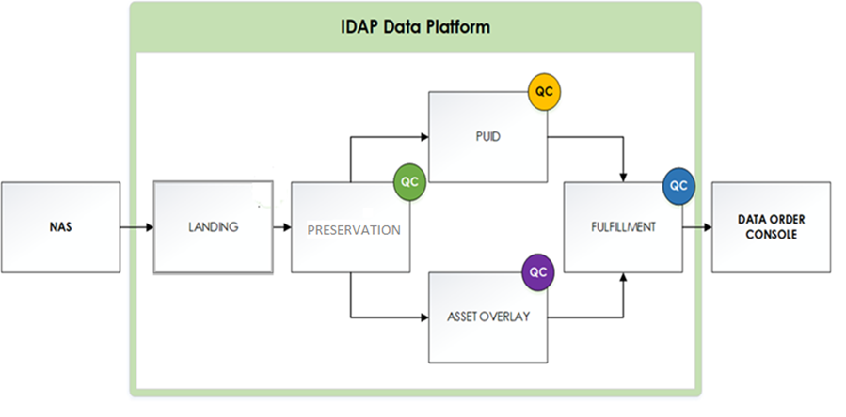
Individual Contribution
Henry Huynh
Quality Check Framework Coverage

Slide 7
Individual Contribution​
Henry Huynh
Project | Description | Location
Documentation | Document containing important information regarding a product (QC Framework) | Confluence Home Page

Slide 8
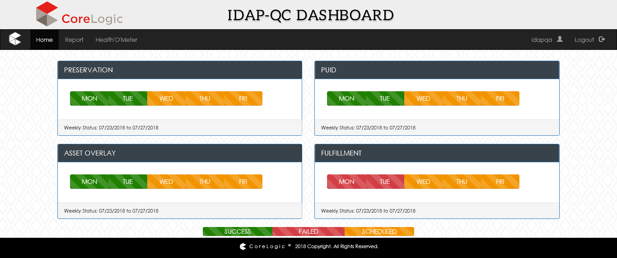
Individual Contribution​
Henry Huynh
Dashboard (Alternative)

Slide 9
Individual Contribution​
Henry Huynh
Project | Description | Location
Dashboard | Reflects the status of the IDAP Data Content Checks by the QC framework | Looker Dashboard

Slide 10
Skills Developed & Lessons Learned
Henry Huynh
Interpersonal Skills:
Time Management & Prioritization
Working with a team as well as managing time efficiently to ensure reaching deadlines with projects and assignments
Experience presenting as well as communicating to senior leaders, as well as utilizing their feedback for individual improvement
Technical Skills:
Handling large real-life datasets
Developed programming language skills of SQL to manipulate and sort through data.
Used SQL language to help create a dashboard that displayed the status of each framework
Developed skills in documentation

Slide 11


Slide 12
EDG Ticketing System Data Mining Project
Ticketing Analytics Dashboard

Slide 13
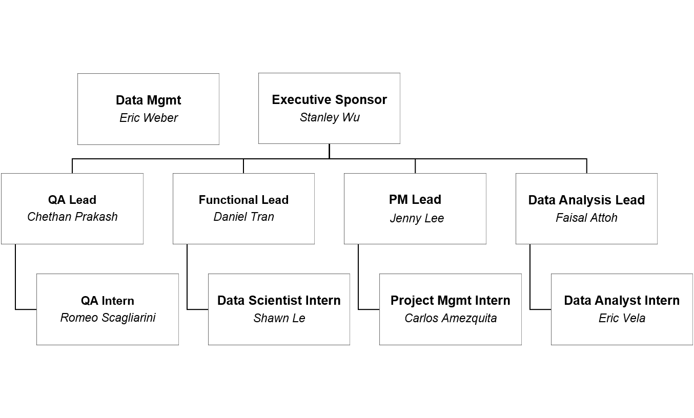
The Ticketing Analytics Dashboard
Project Organizational Chart

Slide 14

EDG 2018 Summer Intern Project
ICP Tickets
ICP tickets document and track customer issues regarding EDG data assets
Monitoring/analytics of incoming tickets & ticket quality
Analysis of historical tickets
Recommendations for improved ticket monitoring and reporting

Slide 15

The Ticketing Analytics Dashboard
Success Criteria
Deliverables should include:
Interactive dashboard in Looker with required elements
Pushed reports/alerts on selected metrics​
Report/tracking of ticket data quality
Forecast ticket count – model​​
Reports on historical patterns, root-cause, analyst behavior
Recommendations on data quality rules​
ID largest offenders, fields or areas​
Recommendations for additional data monitoring for QA​
The correlation of the ticketing that leads to action​

Slide 16
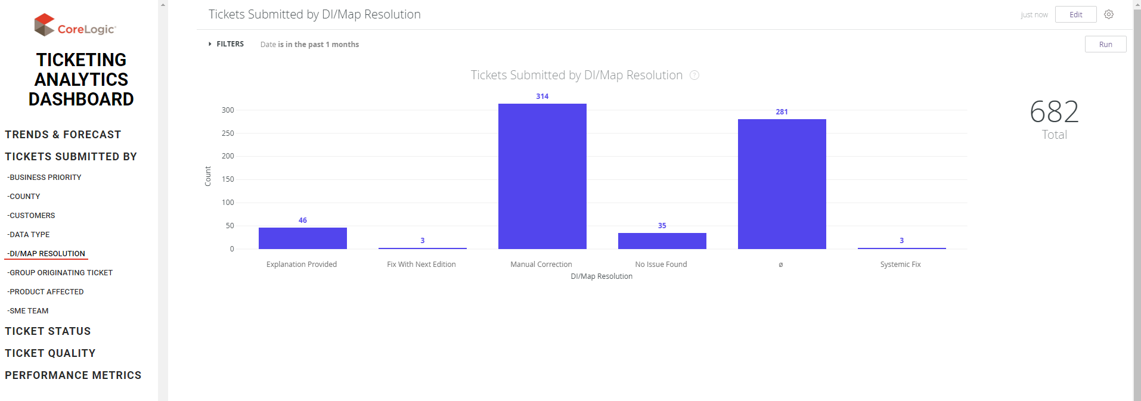
The Ticketing Analytics Dashboard
Demo & Use Case

Slide 17
The Ticketing Analytics Dashboard ​
Solution Diagram

Slide 18
The Ticketing Analytics Dashboard
QA Results
Final Test Results
Total Test Cases executed | 232
Total Test Cases not executed | 2
Total Test Cases failed | 33
Total Test Cases passed | 199
Total defects reported | 23
Testing Cycle Duration (Days) | 3.5
Defects Found per Day | 6.6
Percent Success | 85.8
Final QA Test - Defect Results
Defects Found | 23
Defects Fixed | 14
Defects Mitigated | 7
Defects Deferred | 2

Slide 19
Findings and Recommendations
Root Cause Analysis
Findings
Fields frequently left null
Average of 6.25 critical missing fields per ticket since 2016
Many ETA Due Dates left null
Affected Parcel Number field often populated with a non-numeric value
Recommendations
Make critical fields mandatory to be filled out before submission
Auto population of fields
Completion date and status
ETA due date
Parcel breadth field changes
Affected APN field
Scope field

Slide 20
Individual Contribution
Romeo Scagliarini

Slide 21
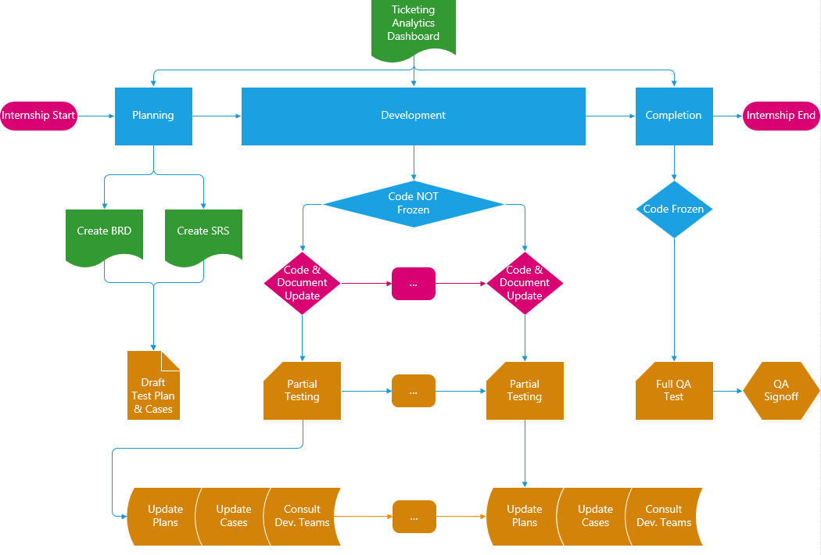
Individual Contribution
Romeo Scagliarini​
Notes:
Talk about the internship as a whole and my main roles throughout this process

Slide 22
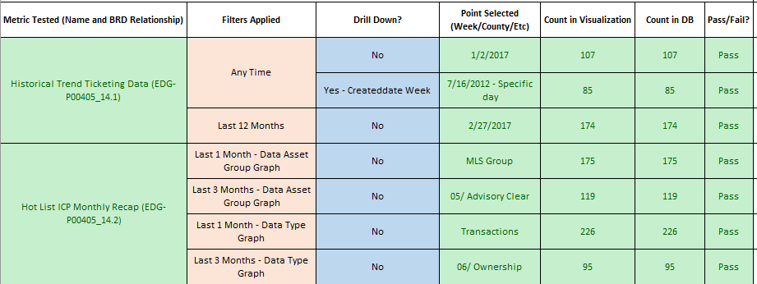
Individual Contribution​
Romeo Scagliarini
Created Test Plan
Functional Testing
System Integration Testing
Data Validation Testing
Model Testing
Drafted Test Cases
Utilized ALM for Defects
Mitigated, Fixed or Deferred all

Slide 23

Individual Contribution
Romeo Scagliarini
RCA
Conducted individual research
Compiled final version
Ticketing Analytics Dashboard
Developed dashboards for metrics and drill downs
Created preliminary user interface
Design work with HTML/CSS
Documentation
Updated Business Requirements Document (BRD)
Wrote Software Requirement Specification (SRS)
Helped with all other formal documents

Slide 24

Individual Contribution
Romeo Scagliarini
Technical Skills
Formal Writing/Documentation
Testing Strategies
Web Development
SQL
Looker/LookML
Lessons Learned
Balance Work and Life
Prioritize To-Do List
Be Receptive to Feedback
Take Initiative
Communication -> Collaboration

Slide 25
Individual Contribution
Carlos Amezquita

Slide 26
Individual Contribution​
Carlos Amezquita
Execute a project plan
Scheduled interviews with stakeholders
Prepare and present project progress reports to stakeholders
Track project milestones and deliverables
Consolidate and publish stakeholder requirements to team
Conduct daily scrum project meetings
Prepare documentation and write requirement specification
BRD (business requirements document)
SRS (software requirement specification)
SDD (software design document)
RCA (root cause analysis)
Conducted yearly research

Slide 27
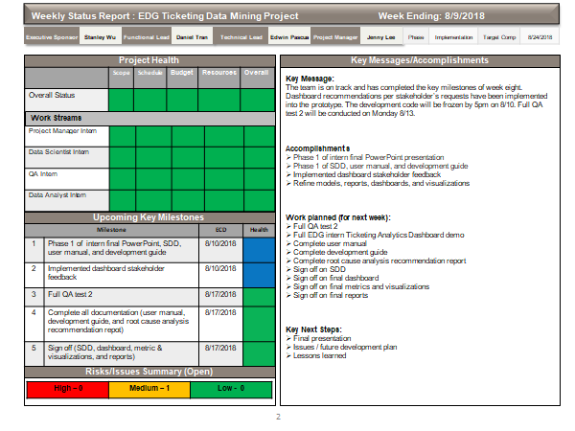
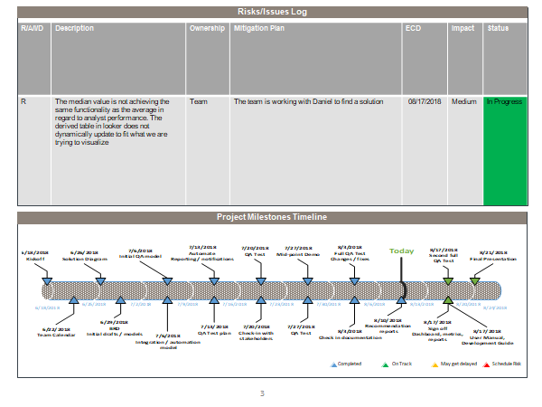
Individual Contribution​
Carlos Amezquita
Weekly status report

Slide 28
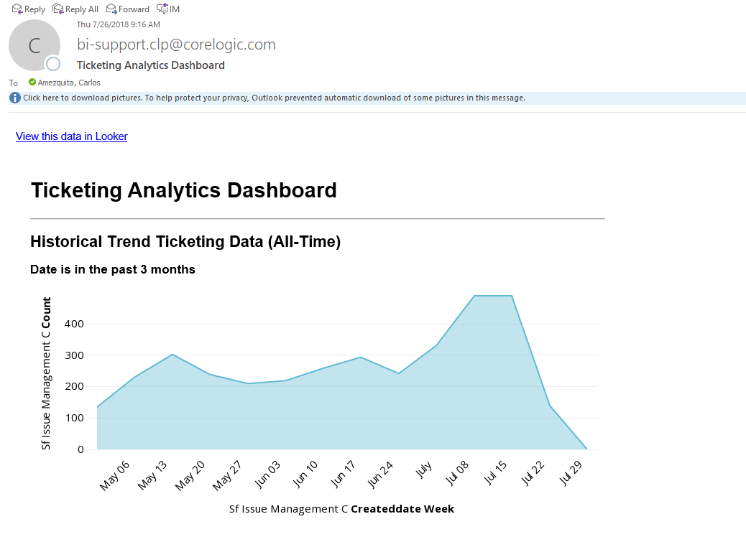
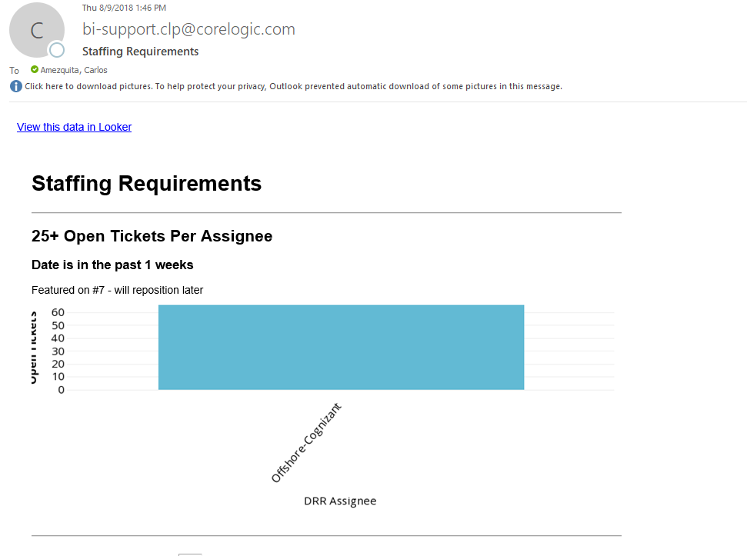
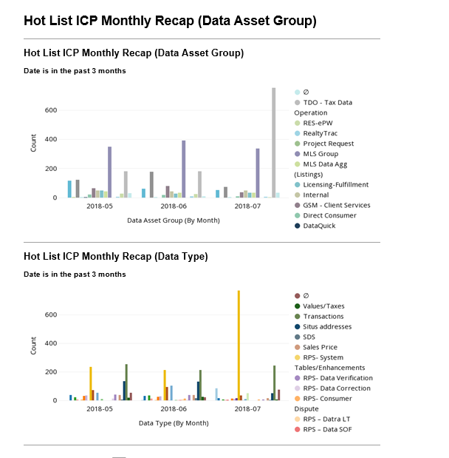
Individual Contribution​
Carlos Amezquita
Email reporting
Threshold alerts
Looker and Salesforce linkage

Slide 29
Individual Contribution​
Carlos Amezquita
Lessons learned / skill development
Lessons Learned | Skills Developed
Pay attention to detail | Communication
Adapt to change | Task Management
Teamwork | Leadership
Commuting is rough | Time Management
Get a good night's sleep | Personal Organization

Slide 30
Individual Contribution​
Shawn Le

Slide 31
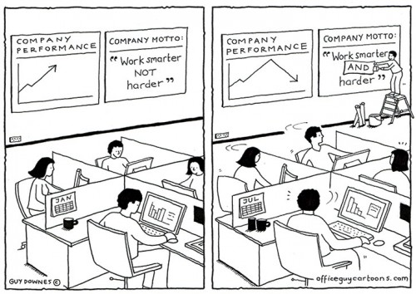
Individual Contribution
Shawn Le
Overall Goal
To provide the DRR team predictive capabilities through modeling and forecasting potential ticket volume.
Can be used to allocate resources appropriately.
Can be used as an evaluation tool for analyst performance.

Slide 32
Individual Contribution
Shawn Le
Solution Diagram

Slide 33
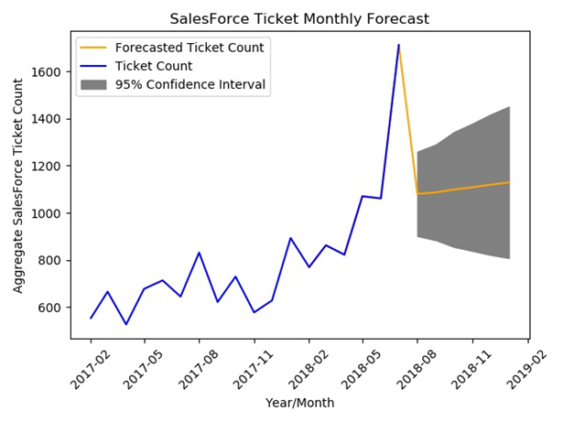
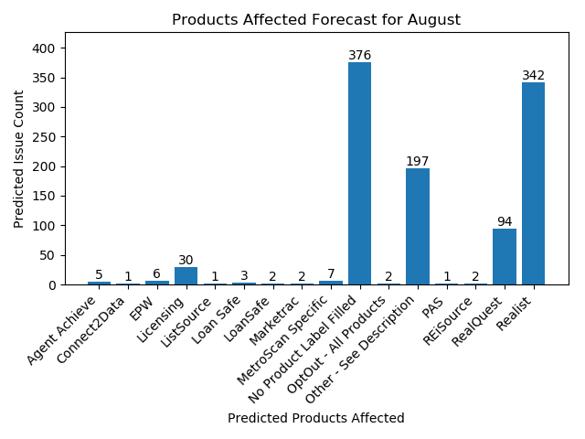
Individual Contribution
Shawn Le
Developed a Univariate Time Series model analyzing ticket volume.
Implemented Model Quality Tracking.
Developed an extension to the ARIMA model by breaking down possible products affected.
Automated process – runs everyday, updates every month!

Slide 34
Individual Contribution
Shawn Le
There is no "I" in team for a group project:
Carlos:
Helped contribute to the Root Cause Analysis by writing up findings year by year.
Eric:
Helped add Looker drills in initial dashboard drafts.
Romeo:
Helped make QA testing easier by having specific automated code.
Group:
Documentation (SDD, User Guide, User Manual, etc...)

Slide 35
Skills Developed & Lessons Learned
Shawn Le
Quote from Daniel | Lessons Learned
"I found that in one Google search" | Being more resourceful also takes effort.
"A great data scientist can utilize whatever tools provided" | Be able to adapt quickly – especially on the job.
"We live and learn everyday" | Every mistake is a lesson.
"Just do it" | Just do it
Situation | Skills Developed
Status Reports | Public Speaking
SCRUM, Divvying up tasks | Teamwork
Data Analysis | Python, SQL, Looker
Forecasting | Statistics

Slide 36
Individual Contribution
Eric Vela

Slide 37
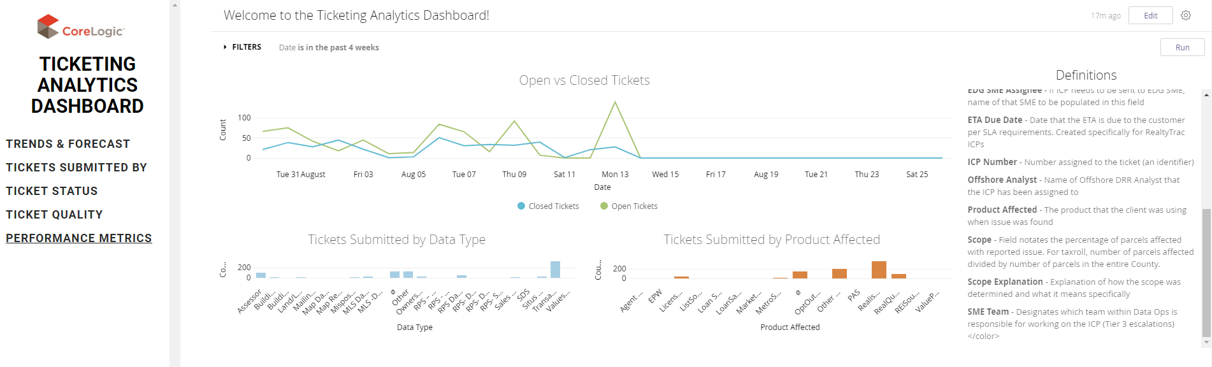
Individual Contribution
Eric Vela
Initial Data Profile and Exploratory Data Analysis
Heavily developed the Ticketing Analytics Dashboard
Researched solutions and wrote SQL queries
Created interactive visualizations in Looker
Implemented user feedback and recommendations

Slide 38
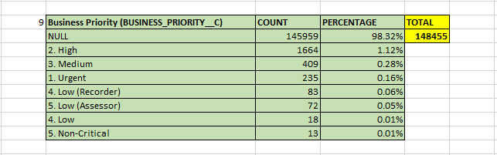
Individual Contribution
Eric Vela
Created a Root Cause Analysis (RCA) Profile
Highlighted critical areas to examine and methods of approach
Summarized the Ticketing Analytics Dashboard in the SDD
Provided developer insight to Looker through the User Manual and Development Guide

Slide 39
Skills Developed & Lessons Learned
Eric Vela
Skills Developed | Lessons Learned
Problem Solving | Avoid the I-5 (if possible)
Looker | Conceptualize before you actualize
SQL | Be adaptable
Prioritization | Schedule...everything.
Communication | No Iron Shirts are amazing.

Slide 40
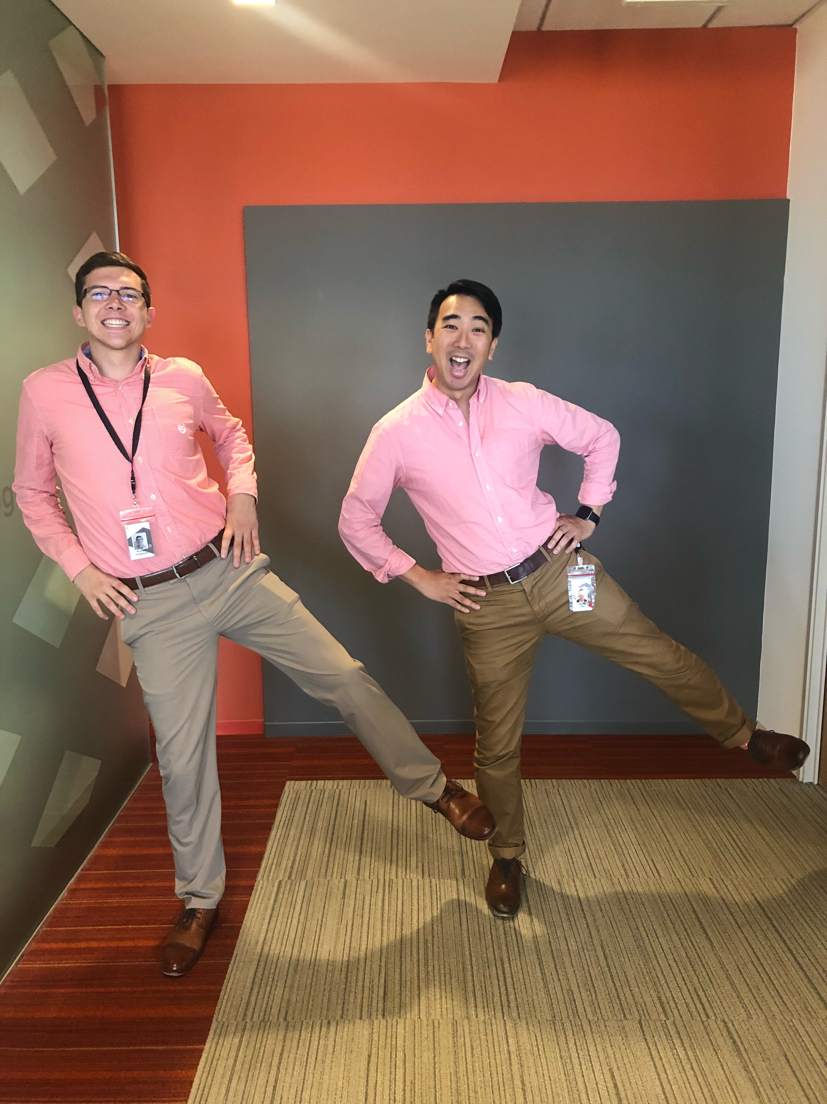


Slide 41
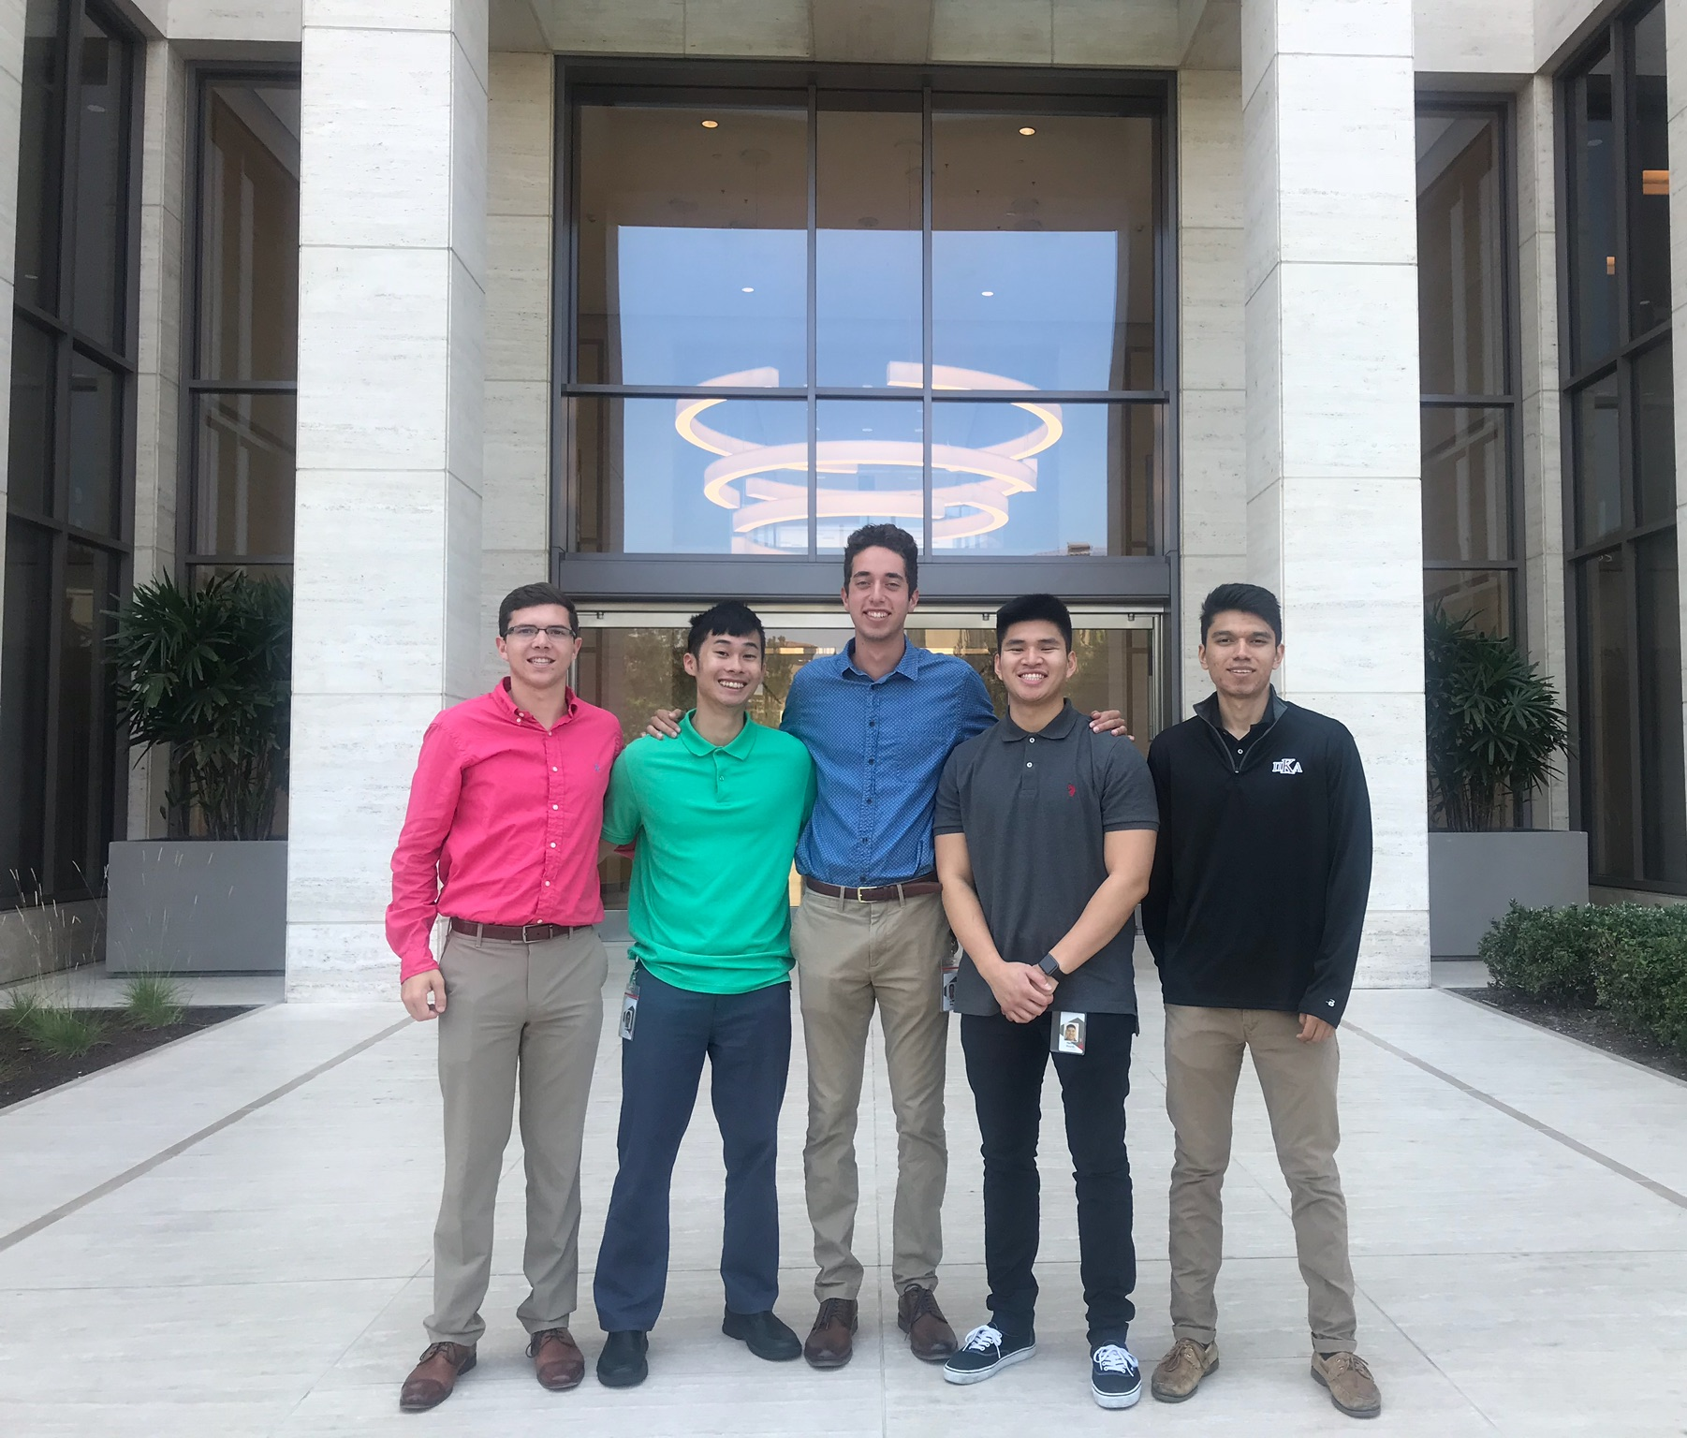
Q & A

